Slide 1
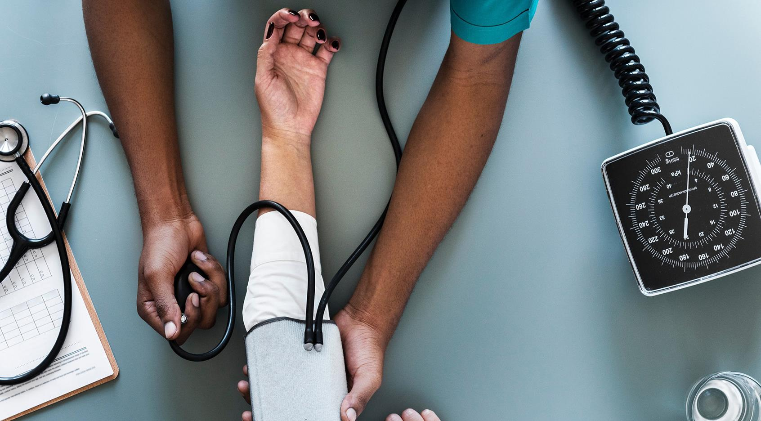
Digitalized Business Processes for Family Doctors
Burrata Health Solutions
Automated appointments, consultations and prescriptions
Notes:
Dear family doctors, software vendors and guests. In the name of Burrata Medical Solutions I welcome you to our presentation about Digitalized Processes for Family Doctors.

Slide 2
Agenda
1
2
3
4
About Us
The Use Case
Challenges
Our Product
Notes:
In our presentation I will present you our team, explain the use case, elaborate the challenges for family doctors and patients and we will have a look at our innovative Product.

Slide 3
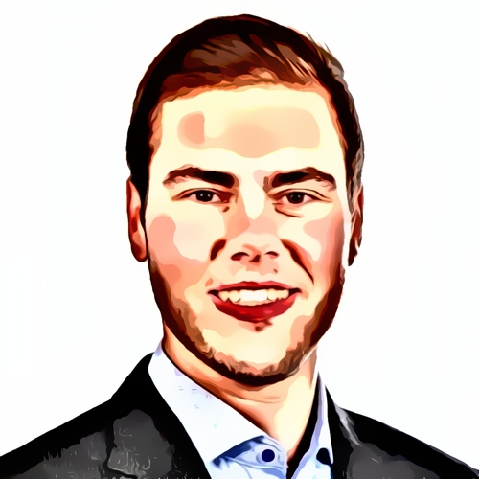
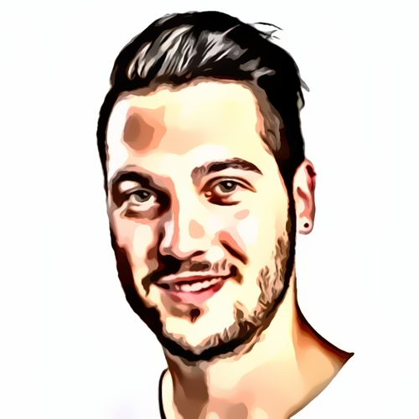
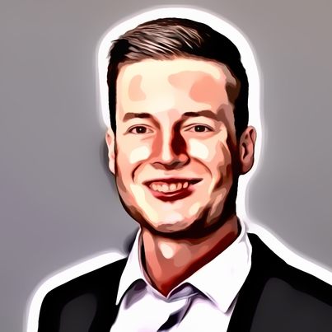
About us
Martin Schmitz
Kevin Saner
Lars Moser
Head of Software Engineering
Head of Technology
Head of Sales
Notes:
The team of Burrata Health Solutions is led by Martin Schmitz our ace in Software engineering, Kevin Saner the man to call when it comes to innovative technologies and myself as Head of Sales.

Slide 4

The Use Case: Appointment with family doctor
Patient needs a (follow-up) consultation
Schedules appointment on phone with medical assistant
Patient travels back home
Patient travels to doctor’s office
Prescription for patient is issued
Patient is registered
Consultation takes place
Notes:
As we have family doctors in audience our use case of an Appointment with the family doctor will sound quite familiar to you.

Slide 5




Challenges
High amount of manual tasks
Long and inconvenient travel times for patients
Many tasks incl. documentation are still paper-based
Inefficient processes result in high health costs
Notes:
Let‘s talk about the challenges. We are well aware that there are a lot of manual and administrative tasks involved in your everyday work, already stressed patients have to travel or are driven by relatives to the doctor‘s office and many tasks such as documentation are still paper-based. The one’s I just named and many other inefficient processes lead to high costs for you and the society.

Slide 6

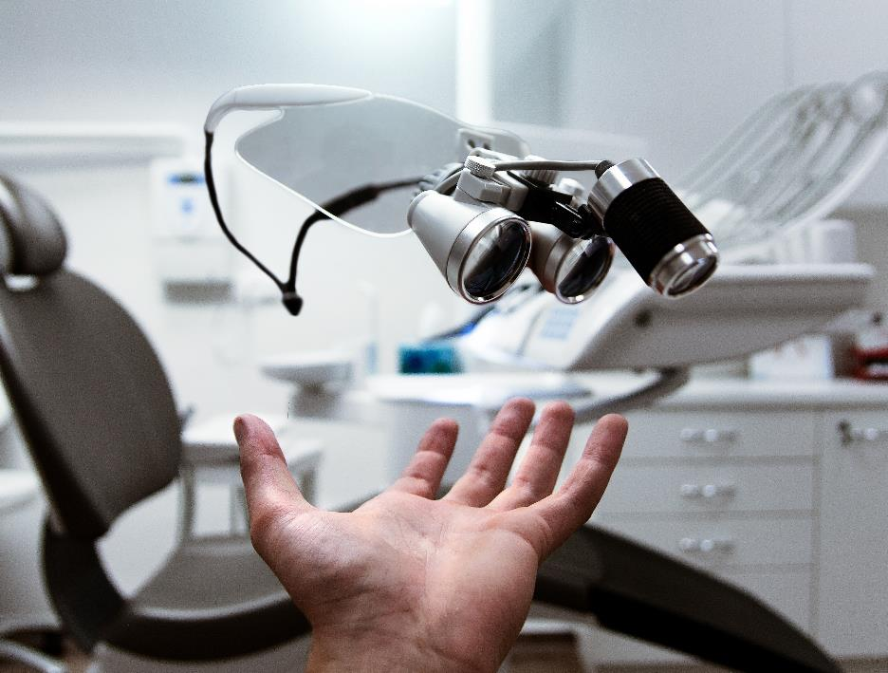
Is there a solution to tackle those challenges?
Notes:
So, is there a solution to tackle all those challenges? Luckily, there is!

Slide 7
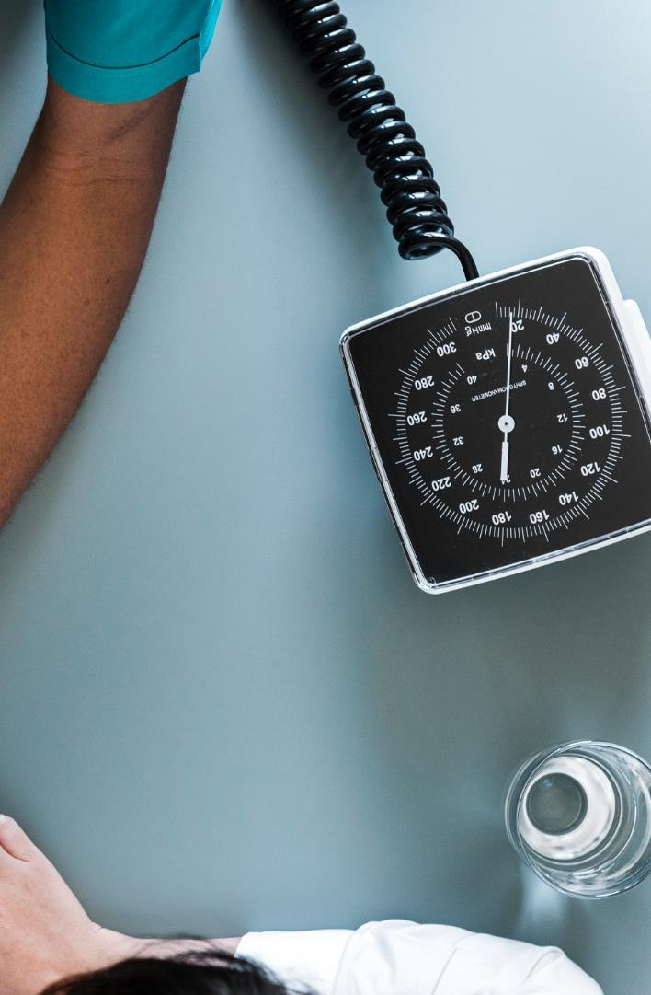



Medical Chatbot
Remote prescription module
Automated diagnosis
Fully digitalized scheduling process
Product features
Notes:
The Medical Chatbot of Burrata Health Solutions. It consist of three pillars. We have a Fully digitalized scheduling process, Diagnosises can be made automatically and there is the Remote prescription module.

Slide 8

How does it work?
Notes:
I am going to explain to you how the Medical Chatbot works in two patient stories. The first is about scheduling an appointment and in the second we will issue a prescription for a patient.

Slide 9

Patient Story 1: Scheduling an Appointment
Patient Details
Name: Natascha Romanov
Status: New patient
Pre-existing conditions: Chronic disease
Notes:
Let‘s start with Scheduling an Appointment. Our patient is Natascha Romanov, she is a new patient and has a chronic disease. Please turn up the volume of your computer for the demonstration.

Slide 10
Patient Story 1: Scheduling an Appointment
Benefits
No human interaction from the doctor’s office is necessary
No unintentional date overlaps
E-mail confirmation for patient
Notes:
Benefits read slides

Slide 11
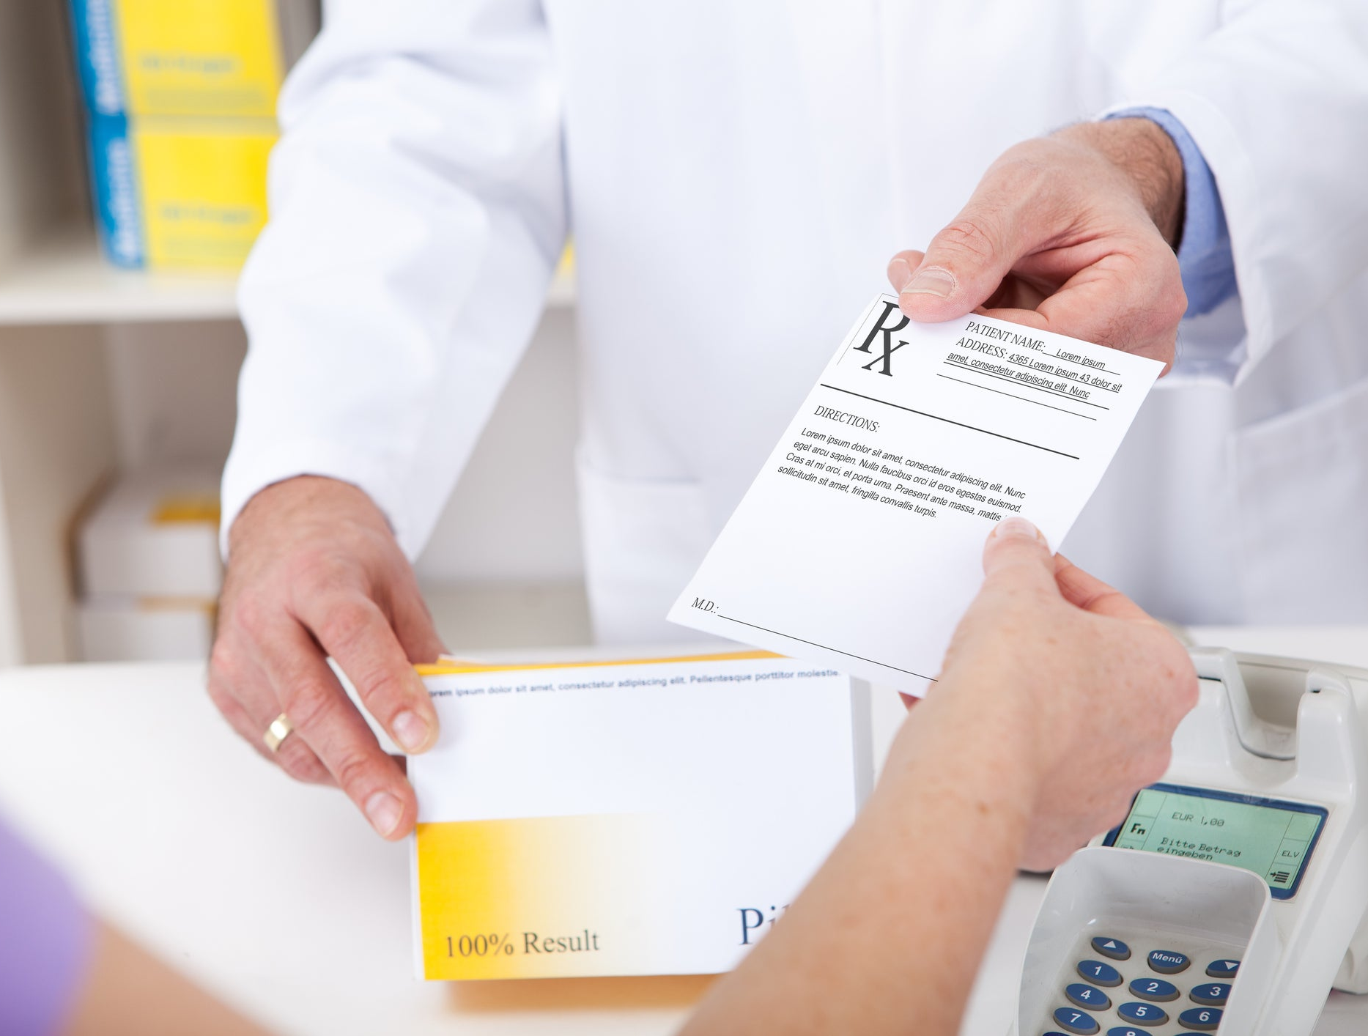
Patient Story 2: Issue a prescription
Patient Details
Name: Tony Stark
Status: Existing patient
Pre-existing conditions: None
Symptoms: Headache
Notes:
In our next scenario we will issue a prescription. This time we have Tony Stark who is and existing patient and has a headache.

Slide 12
Patient Story 2: Issue a prescription
Benefits
Patients no longer must travel to the doctor office which reduces stress
Automatic documentation of patient’s answers and doctors' actions
Prescriptions are still checked by a doctor
Patient automatically receives prescription via email
Notes:
So what benefits will you get from our Medical Chatbot in this case? Read slide.

Slide 13
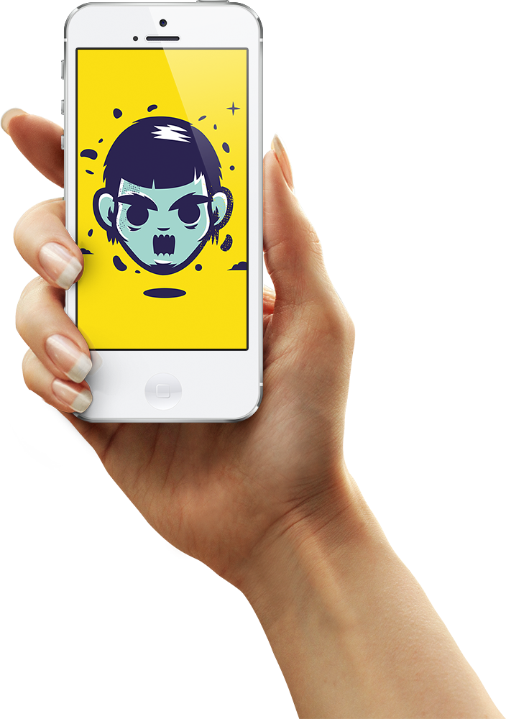
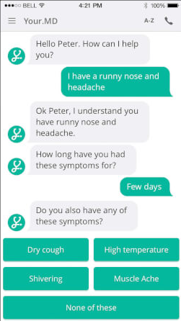




Medical Chatbot
Easy way to make appointments
Automatic diagnoses based on a symptom checker
Prescriptions are issued remotely
More time for patients
Less paperwork
Cost reduction
Happier patients
Notes:
Our Medical Chatbot offers you an easy way to make appointments with your patients, Diagnoses are made automatically based on a symptom checker and Prescriptions are issued remotely.
As a result you can spend more time with patients who need physical examinations, you have less paperwork, costs are reduced, and you will have more satisfied patients.

Slide 14




Thank you for your attention!
Lars Moser, Head of Sales
+41 32 452 33 55
lars.moser@burratahs.com
www.burratahs.com
Notes:
If there are any questions from your side our team happily answers them. But before that, I would like to thank all of you for your attention!

